Slide 1
Airbnb Price Determinants
Team Members
201512019 Rana Gürcü DELİÖMEROĞLU
201514039 Merve KARAKAYA
201627015 Melisa YILDIZ
201611033 Selin KARA
Advisor
Dr. Roya CHOUPANI

Slide 2
Contents
Problem
Objectives
Solution
Implementation
Conclusion
References

Slide 3
Problem
Airbnb is a worldwide house and property rental platform that provides short-term accommodation services to those who prefer houses to hotels
In recent years, people prefer to use platforms such as Airbnb, which determine the price according to the characteristics of the place they will stay, instead of fixed and generally high-priced hotels during their touristic trips and holidays

Slide 4
Objectives
Airbnb is different from other types of accommodation due to its structure. This is why Airbnb pricing strategy requires different approaches
Different methods are used in this pricing strategy. This situation differs from country to country, from city to city, and even in regions within the same city
There are many factors for pricing policy

Slide 5
Solution
A pricing platform is offered as a solution proposal to the specified problem for hosts
In other words, the platform we will create for Airbnb's pricing policy is a web application

Slide 6

Implementation
Backend
Data Exploration
Data Cleaning
Feature Importance
Model Building
Frontend
Flask API
Design

Slide 7
BACKEND

Slide 8
Data Exploration
Airbnb Turkey Istanbul data set was used for the platform
This dataset is obtained from the official airbnb records at http://insideairbnb.com/

Slide 9
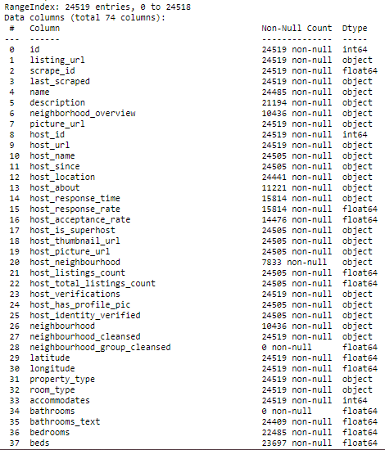
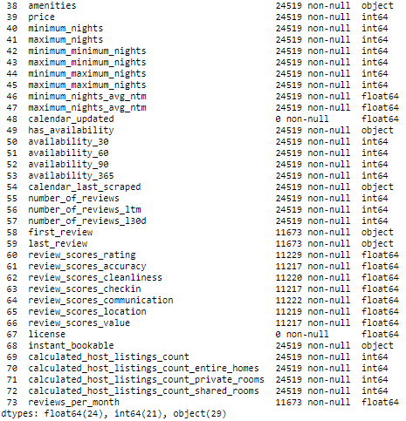
Airbnb Istanbul Dataset

Slide 10
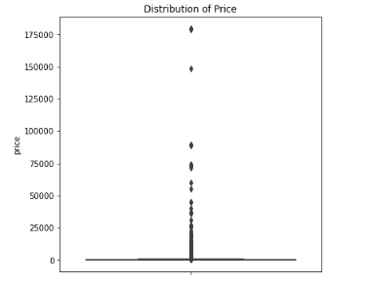
Data Cleaning
Distribution of price record results
(Point 0 :2) between 0-10000 : 24440 (Point 10000:12) between 10000-20000 : 30 between 20000-30000 : 7 between 30000-40000 : 4 between 40000-50000 : 3 between 50000-60000 : 1 between 60000-70000 : 0 between 70000-80000 : 5 between 80000-90000 : 7 between 90000-100000 : 0

Slide 11
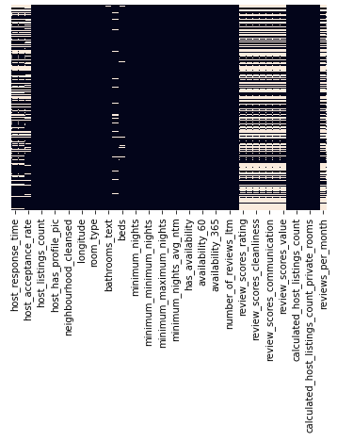
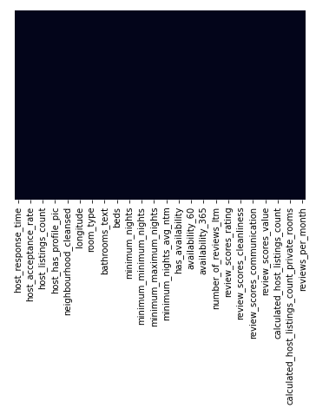
Data Cleaning
Dropping unnecessary features
Handling Missing Data
Completely empty or almost empty columns should be dropped
Filling missing values
Before Data Cleaning
After Data Cleaning

Slide 12

Data Cleaning
Handling categorical features
One hot encoding is used
In this way, records in the object data type are converted to numeric data types and added separately to the end of the data set

Slide 13

Model Building
Random forest regressor was chosen as the model to be trained
For model training, 25% of the data set is reserved for testing and the rest for training
The random forest regressor model is saved as a pickle module for the frontend part
13

Slide 14
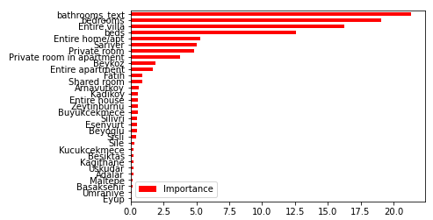
Feature Importance
The feature selection process was applied to examine the effect of the features in the data set on the price
During this process, some of the features that had a low feature selection coefficient and were not suitable for the main purpose of the project were eliminated
As a result of this section, the main features presented in the frontend and their sub-features have emerged

Slide 15
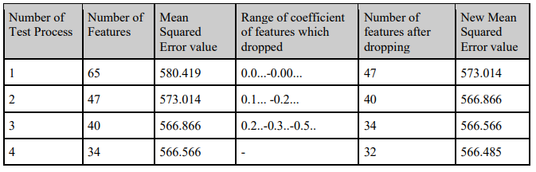
Feature Importance
Table of model test

Slide 16
FRONTEND

Slide 17

Frontend
Flask library of python is used to connect the created pickle model with web design technologies
Web technologies such as HTML and CSS were used for the design of the front of the platform

Slide 18
Conclusion
As a result, thanks to the Innovative System Design and Development I-II courses, we learned some machine learning algorithms and the models in which these algorithms are applied while examining the literature studies of similar projects
Additionally, we had the opportunity to examine Airbnb data sets, make sense of the data and use them in models
After choosing the appropriate data set for Airbnb Istanbul, we tried the algorithms and models we will use for price prediction and developed the model that could best predict the data set.
18

Slide 19
DEMO
https://www.youtube.com/watch?v=m7LYzj3Ubro

Slide 20
References
https://www.airbnb.com.tr/
http://insideairbnb.com/

Slide 21


THANK YOU

